Slide 1

MSDSonline HQ: General User Site Tour
Main Menu
Getting to your eBinder
Searching within your eBinder
Searching by Locations
Filters
How to View and Print an (M)SDS
Product Card and Summary Panel
Product Summary
How to Print a Secondary Container Label
What to Do When You Can’t Find an (M)SDS
How to Submit a Request for an (M)SDS
Dashboard Overview
Slide 1

Slide 2
How to get to your eBinder
There are several ways a company may choose to
provide access to their safety data sheet inventory using the
MSDSonline HQ system:
A designated URL (Web page) on the Internet
A shortcut icon on a user’s PC/desktop
A link on the company Intranet site
Be sure to ask your account’s administrator which method
has been implemented at your company.
Getting to your eBinder
Slide 2

Slide 3
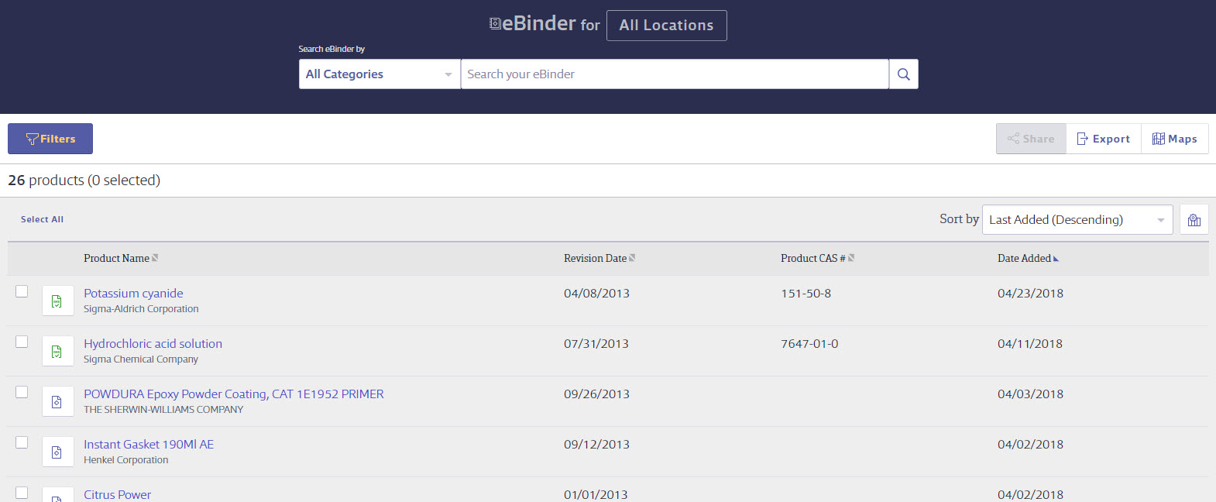
Search Your eBinder
Search your eBinder for an (M)SDS. The single search field allows you to search by product details, including Product Name, Manufacturer, CAS#, and Product Code.
Use the Search eBinder by dropdown to narrow your search by Product Name, Product Code, Manufacturer, Product CAS #, Document ID, Ingredient, Ingredient CAS #, Custom 1, or Custom 2.
Searching within your eBinder
Slide 3

Slide 4
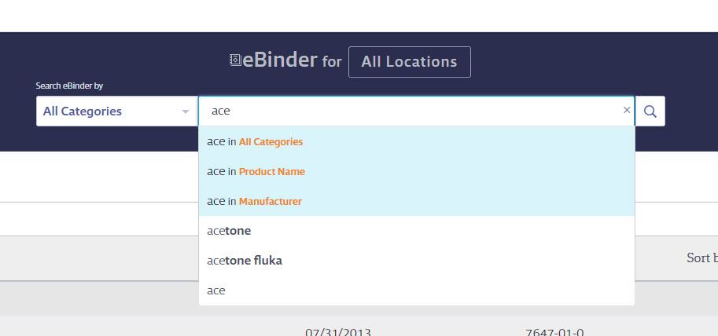
Search Suggest
Use Search Suggest as you are typing to see what possible matches might exist within your eBinder. Select a suggestion and click Search.
Searching within your eBinder
Slide 4

Slide 5
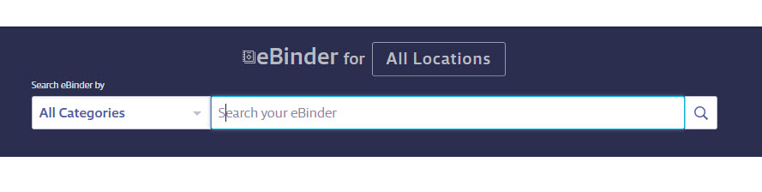
Searching for Specific Locations
Choose the specific location where your Product is located by clicking on the Locations button.
Searching by Locations
Slide 5

Slide 6
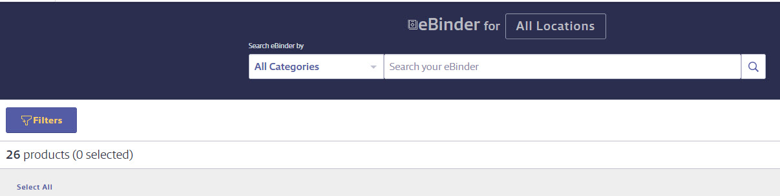
Filters
To narrow your search by more specific details, select the Filters button for a modal with additional filter options.
Filters
Slide 6

Slide 7
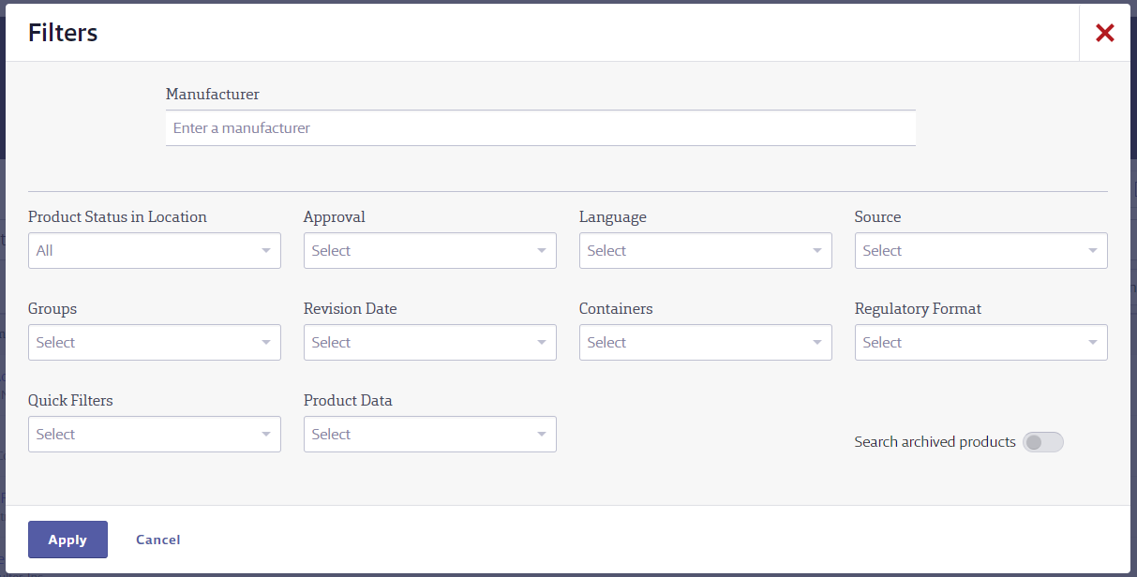
Manufacturer Search:
Enter the name of a specific manufacturer to narrow your search.
Filters
Slide 7

Slide 8
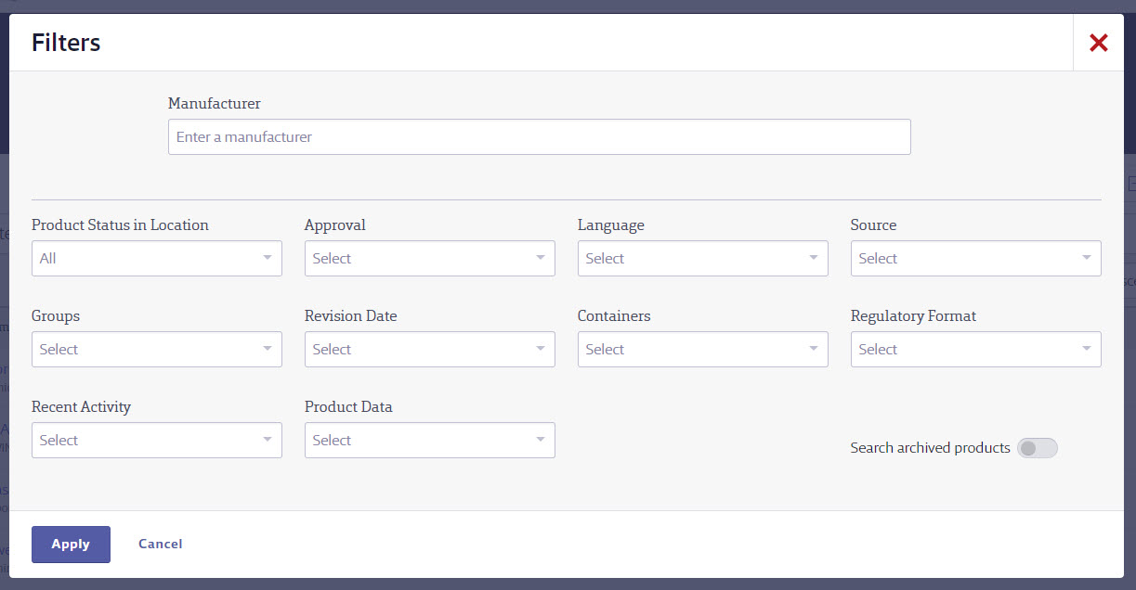
Product Status in Location:
Filter products that are not in use or in use.
Approval:
Filter by approved, pending, or not approved products.
Language:
Filter by (M)SDSs in specific languages.
Source:
Filter products by the source from which they were added.
Filters
Slide 8

Slide 9
Groups:
Choose the specific group by which the product is categorized. These options are setup by the administrator.
Revision Date:
Filter for products with revision dates less than 1 to 5 years.
Containers:
Filter by products with or without containers.
Regulatory Format:
Filter by the different regulatory formats (i.e. Canadian WHMIS, GHS SDS, US ANSI).
Filters
Slide 9

Slide 10
Quick Filters:
Filter by banned, discontinued products, or multiple versions.
Product Data:
Specific details may have been indexed from each product’s (M)SDS. Select a specific detail to filter your search results based on that Product Data.
Search archived products:
Filtering by archived products within your company list.
Filters
Slide 10

Slide 11

Select All:
To quickly select all search results, click Select All. This will update to Deselect All after selected.
Sort By Dropdown and Columns:
The Sort By dropdown is another way to quickly sort selecting from a list. The options in the drop down are based off the columns selected. The Edit Table icon allows you to select up to 3 additional columns (besides Product Name) to show in eBinder.
Column Header Arrows:
To quickly sort products, select the arrow icon next to the column header.
Search Result Functions
Slide 11

Slide 12
Maps:
Allows you to view a map of where containers in your account are located.
Export:
Use the Export icon to output the current search results list to an Excel spreadsheet.
Viewing an (M)SDS:
In the search results list, look for the PDF icon. Select the icon that corresponds with the desired product to open the (M)SDS.
The document will open in an Adobe Reader window. Adobe Reader must be installed in order to view the (M)SDS.
Search Result Functions
Slide 12

Slide 13

Share:
Gives you the options to share the Product URL either by copying/pasting the link or email directly.
Labels:
Gives you the options to create and print secondary container labels.
Checkbox:
When clicked, the checkbox gives you options to create and print secondary container labels and share the product URL.
Search Result Functions
Slide 13

Slide 14
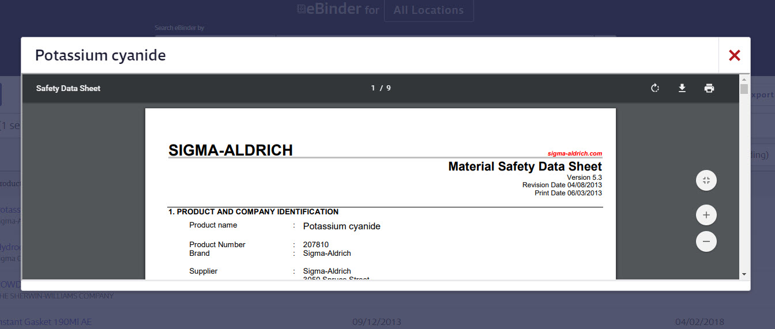
Close the MSDS:
Click the X to close the MSDS
Printing an MSDS:
Select the Print icon to send the MSDS to a local printer
Rotate Clockwise:
Use the rotate clockwise icon to rotate the MSDS.
Download:
Select the Download icon to save a .PDF copy of the MSDS.
Zoom In/Out:
Select these buttons to either Zoom In, Zoom Out, or Fit to Width.
Scroll Bar:
Use the scroll bar to navigate through the MSDS.
How to view and print an (M)SDS
Slide 14

Slide 15
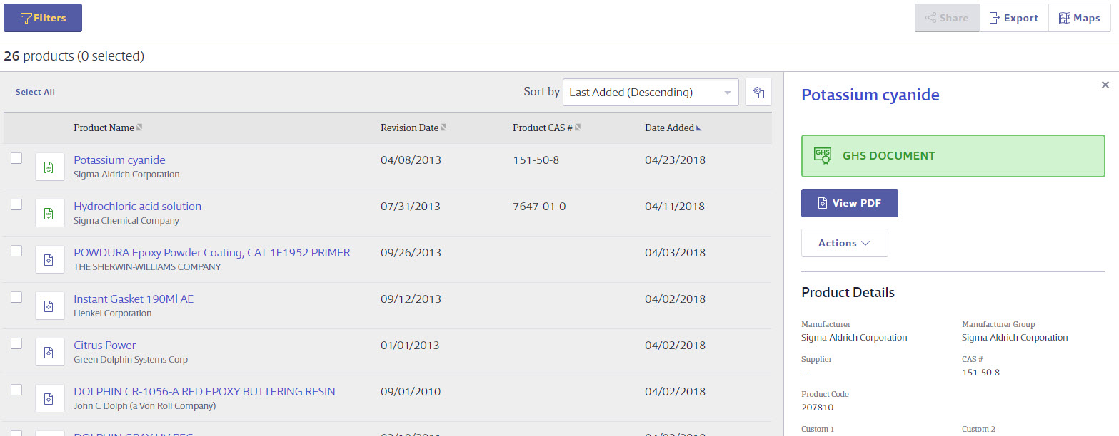
Summary Panel:
High level overview of the Products Details, Product Inventory, and SDS Information. Allows you to also view the PDF, Print Labels, and Share the Product URL.
Product Row:
Click on the gray bar to open the Summary Panel. Click on the product name to go to the full Product Summary page.
Product Card and Summary Panel
Slide 15

Slide 16
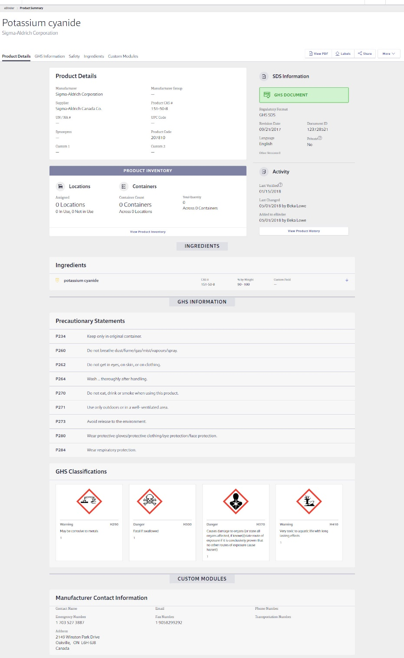
Viewing the Product Summary
The product summary allows you to view a quick snapshot of details about the product, and enables you to view the (M)SDS, create workplace labels, and view attached files.
Indexing Modules
Scroll through the modules to see what details have been indexed for this product. Modules must be enabled and indexed by administrators.
Product Summary
Slide 16

Slide 17
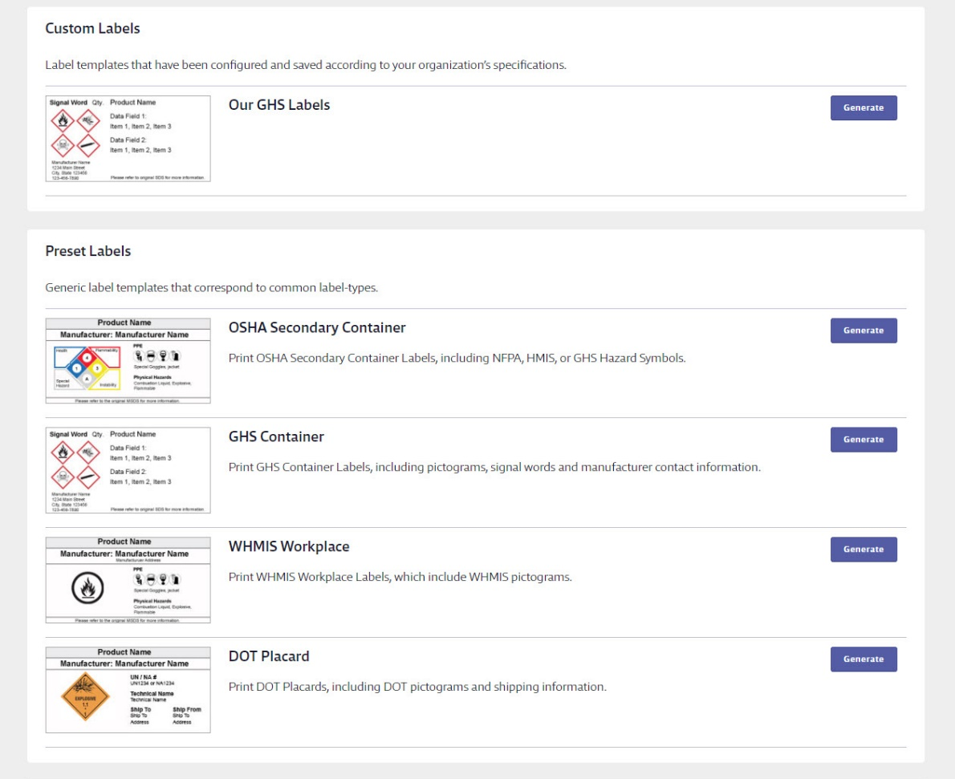
Printing Secondary Container Labels
Select the specific workplace label required by clicking the Generate button. Your account’s administrator may also create custom label templates specific to your organization that can also be selected.
How to print a Secondary Container Label
Slide 17

Slide 18
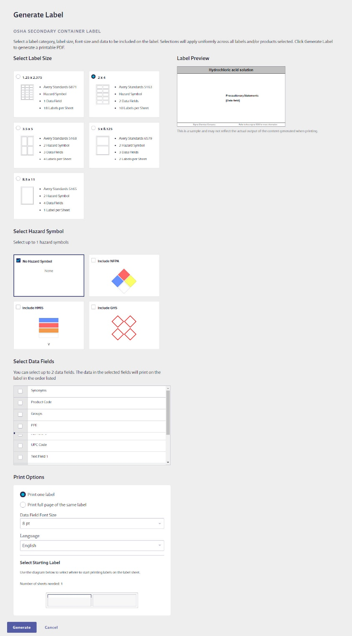
Label Preview:
This will show you a preview of the label that you are creating.
Step 1:
Select a label size.
Step 2:
Depending on your label type, select and reorder the hazard symbols for your label.
Step 3:
Depending on the size of your label, select the data fields you would like to include.
Step 4:
Decide whether to print one label or a full sheet of labels.
How to print a Secondary Container Label
Slide 18

Slide 19
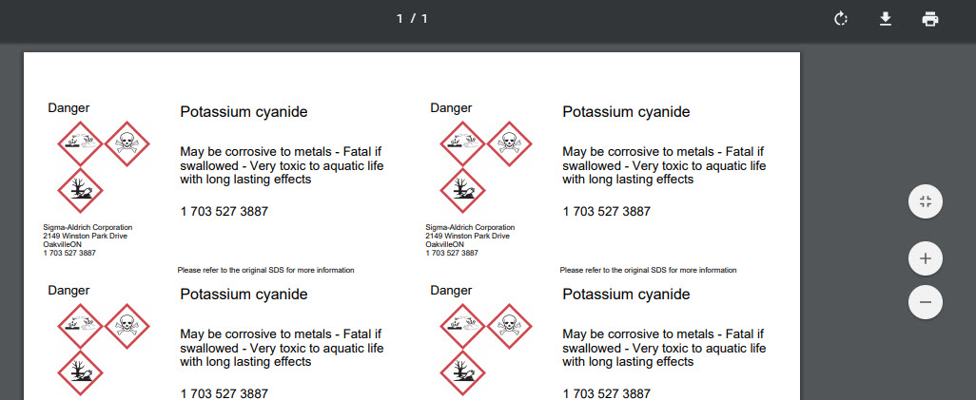
Viewing and Printing a Label
Upon selecting the Generate Label button, a new window will open with your Label preview. Notice the Adobe Toolbar contained in the top and side of the window frame. From here you can rotate, download, and print your label(s).
How to print a Secondary Container Label
Slide 19

Slide 20
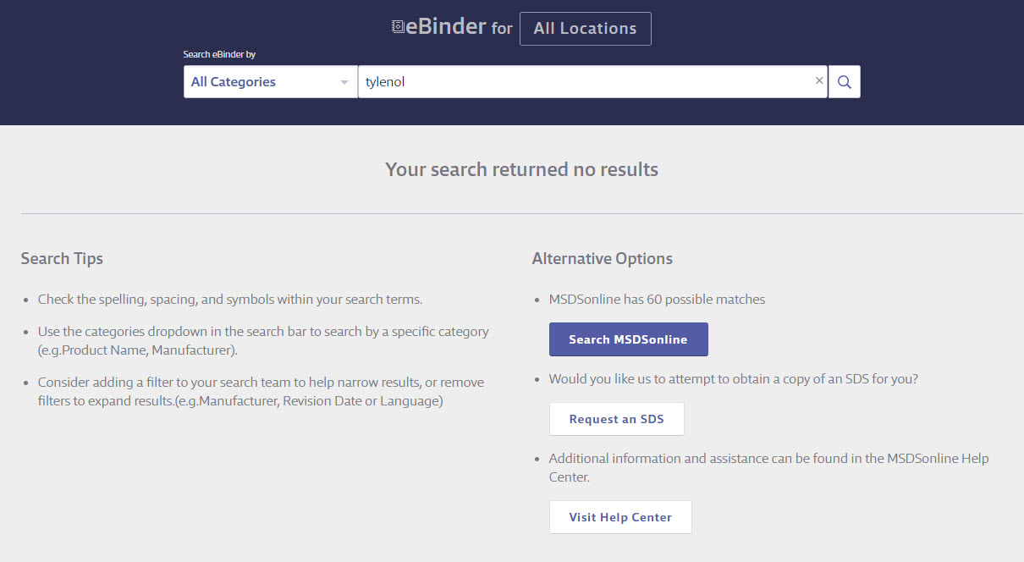
What to Do When You Can’t Find an (M)SDS
Your account may include several options to help when searching your eBinder comes up with zero results.
Searching the MSDSonline Database
Connects users to the MSDSonline database of millions of (M)SDSs. Here, MSDSonline has already searched the database and found matches for your search.
What to do when you can't find an (M)SDS
Slide 20

Slide 21
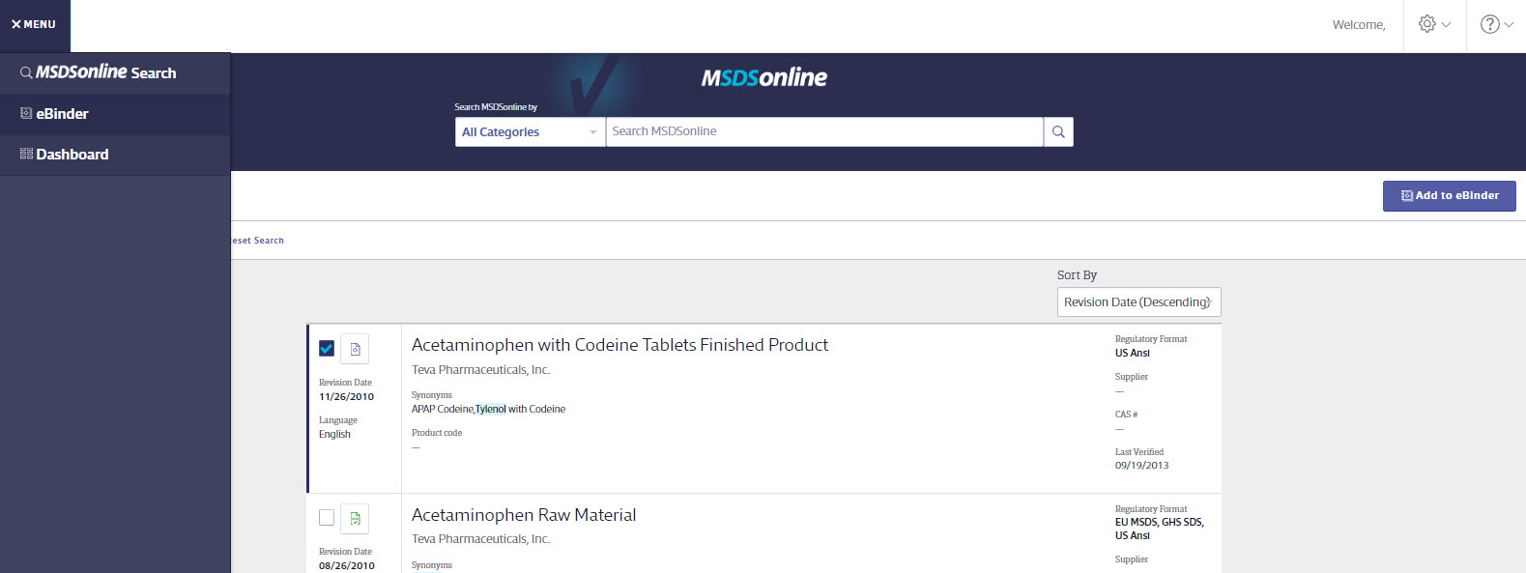
MSDSonline Search Tab
You may also be able to select the MSDSonline Search Tab to access the MSDSonline database under the Menu.
Adding to Your eBinder
Upon finding the product you need, you may be able to request (M)SDS to be added to your company list. Just select the (M)SDS(s) you would like to add click the Add to eBinder button.
What to do when you can't find an (M)SDS
Slide 21

Slide 22
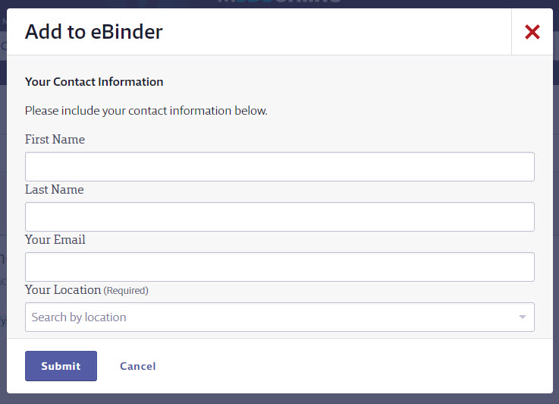
Adding an (M)SDS from MSDSonline to the eBinder
When adding an (M)SDS to the eBinder, you may be prompted to submit your employee information and reason for adding the (M)SDS.
What to do when you can't find an (M)SDS
Slide 22

Slide 23
What to Do When You Can’t Find an (M)SDS
Your account may include several options to help when searching your eBinder comes up with zero results.
Submit a Request for an (M)SDS
Your account may also enable you to submit a request for an (M)SDS to your administrator or direct to MSDSonline.
How to submit a Request for an (M)SDS
Slide 23

Slide 24
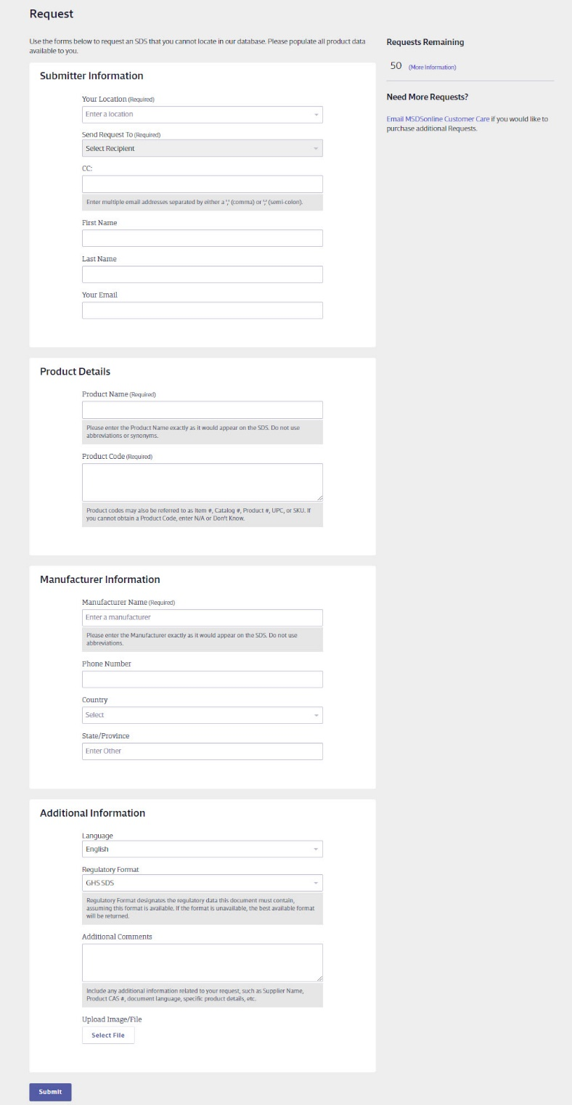
Requesting an (M)SDS
Your account may be enabled to allow employees to submit requests for (M)SDSs to an account administrator or direct to MSDSonline. To request an (M)SDS, simply fill out the form with as much detail as possible. This will help your Administrator or MSDSonline find and add the (M)SDS you need.
How to submit a Request for an (M)SDS
Slide 24

